Slide 1
The crystal Structures of Ionic Materials: Pauling groups, Crystal types: simple cubic (c), body centered cubic (bcc), face centered cubic (fcc/ccp) hexagonal close packed (hcp) etc., tetrahedral and octahedral holes, coordination number, unit cell, crystal systems, Miller indices and their significance.

Slide 2
We can assume minerals to be made of orderly packing of atoms or rather ions or molecules.
Many mineral properties like symmetry, density etc are dependent on how the atoms or ions are packed
We can approximate the atoms or ions in a metal to be rigid spherical balls

Slide 3
Think of a box full of ping pong balls.
The densest packing is one on which a layer of balls sit on the hollow between the balls in the layer below.
The two closest packing are:
Hexagonal close packing (ABCABC)
Cubic close packing (ABAB)

Slide 4
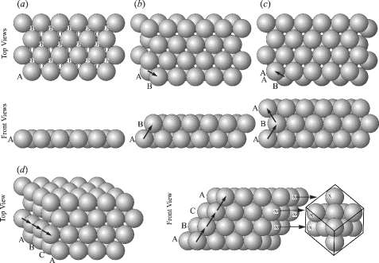
Closest packing of spheres.

Slide 5
Some what less dense packing is body centered cubic packing, seen in Iron.
Because they can be packed so closely, metals have high density

Slide 6
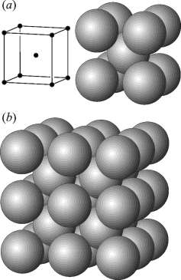
Body-centered cubic packing.
(a) Bodycentered lattice (left) and with atoms at each lattice node (right).
(b) Eight unit cells.
Each sphere is in contact with eight neighbors.

Slide 7
Covalent and Molecular Bonds
Covalent bonds are strong therefore covalent crystals are strong and have high melting point
Because atoms need to be placed in a specific orientation only, covalent crystals do not show a close packing.
The bonds in molecular crystals are weak, hence these tend to be soft.
The geometry of the structure is determined by the shape and charge distribution in the molecules (e.g., Hydrogen bond in water)

Slide 8
Ionic Bonds
For minerals formed largely by ionic bonding, the ion geometry can be simply considered to be spherical
Spherical ions will geometrically pack (coordinate) oppositely charged ions around them as tightly as possible while maintaining charge neutrality
For a particular ion, the surrounding coordination ions define the apices of a polyhedron
The number of surrounding ions is the Coordination Number

Slide 9
Pauling’s Rules of Mineral Structure
Rule 1:
A coordination polyhedron of anions is formed around each cation, wherein:
- the cation-anion distance is determined by the sum of the ionic radii, and
- the coordination number of the polyhedron is determined by the cation/anion radius ratio (Rc:Rx)

Slide 10
Radius Ratio of Cation and Anion (Rc/Ra), Coordination number and Coordination polyhedra

Slide 11
Minimum Radius Ratio | Coordination number | Packing geometry
~1.0 | 12 | Corners of a cuboctahedron (close packing)
0.732-1 | 8 | Corners of a cube
0.414- 0.732 | 6 | Corners of a octahedron
0.225- 0.414 | 4 | Corners of a tetrahedron
0.155- 0.225 | 3 | Corners of an equilateral triangle
<0.155 | 2 | Linear

Slide 12
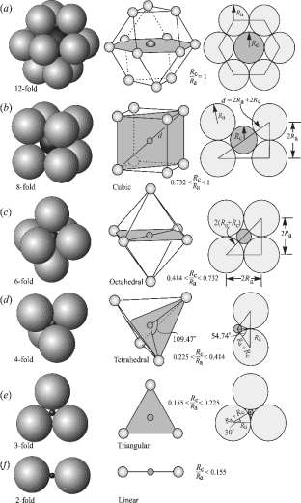

Slide 13
Rule 2: The electrostatic valency principle
The strength of an ionic (electrostatic) bond (e.v.) between a cation and an anion is equal to the charge of the anion (z) divided by its coordination number (n):
e.v. = z/n
In a stable (neutral) structure, a charge balance results between the cation and its polyhedral anions with which it is bonded.

Slide 14
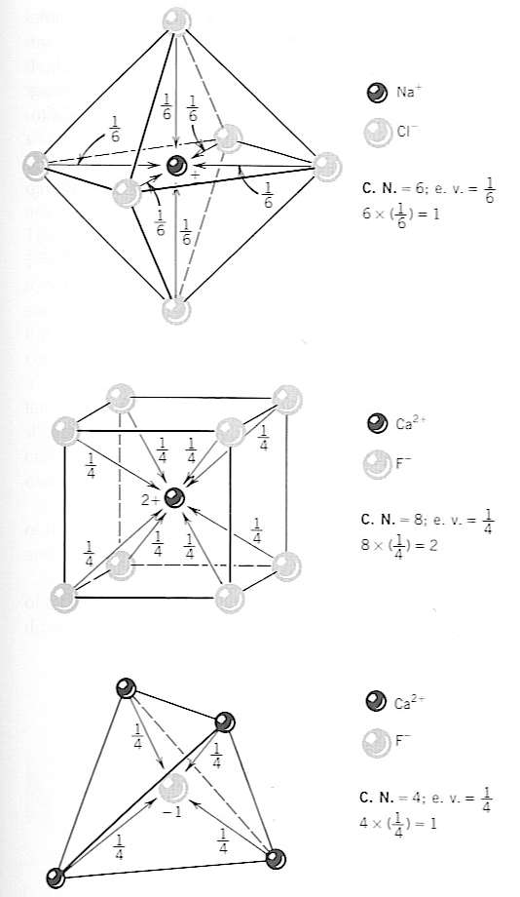
Charge Balance of Ionic Bonds

Slide 15
Uniform Bond Strength
Isodesmic: where all ionic bonds are of equal strength
Anions tend to pack around the cation in highly symmetric and generally close packing arrangement
Most of the minerals crystallize in highly symmetric systems like isometric, tetragonal or hexagonal systems
Oxides, Fluorides, Chlorides are common examples

Slide 16
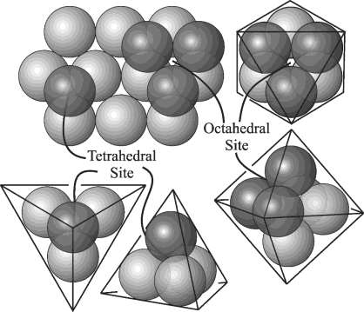

Slide 17
Nonuniform Bond Strength
Some anion-cation bonds are stronger than others: cations forming stronger bonds are smaller and have a high charge
– Eg: C⁴⁺, S⁶⁺, P⁵⁺, Si⁴⁺
– These strongly charged cations from CO₃²⁻, SO₄⁴⁻, PO₄³⁻,SiO₄⁴⁻ anionic groups
Have lower symmetry, irregular coordination polyhedra

Slide 18
Formation of Anionic Groups
Anisodesmic Bonds results from high valence cations with electrostatic valencies greater than half the valency of the polyhedral anions; other bonds with those anions will be relatively weaker.
Mesodesmic: anion-cation bond takes exactly half othe available anioncation charge

Slide 19
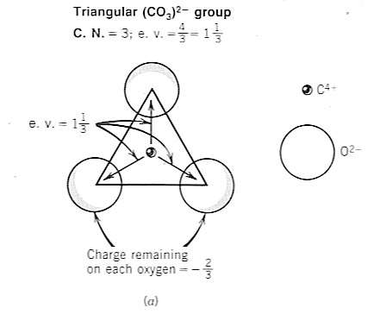
Anisodesmic

Slide 20
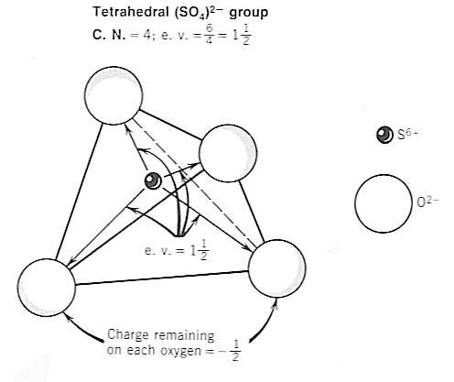

Slide 21
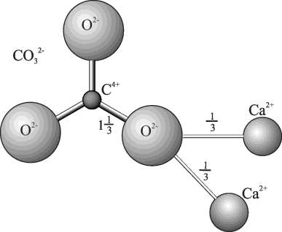
Anisodesmic carbonate (CO₃²⁻) group. Each O–C bond occupies 1.33 of the available –2 charge on oxygen; only two-thirds of a charge on the oxygen is available to bond with other cations such as Ca²⁺.

Slide 22
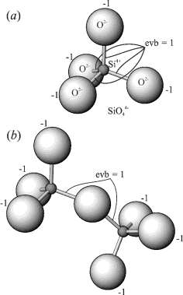
Mesodesmic silicon tetrahedra.

Slide 23
Rule 3: Anion polyhedra that share edges or faces decrease their stability due to bringing cations closer together; especially significant for high valency cations

Slide 24
Rule 4: In structures with different types of cations, those cations with high valency and small CN tend not to share polyhedra with each other; when they do, polyhedra are deformed to accommodate cation repulsion

Slide 25
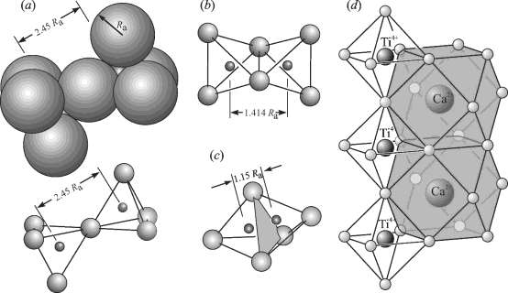
Sharing anions between polyhedra.

Slide 26
Rule 5: The principle of parsimony : nature tends towards simplicity
Because the number and types of different structural sites tends to be limited, even in complex minerals, different ionic elements are forced to occupy the same structural positions – leads to solid solution.

Slide 27
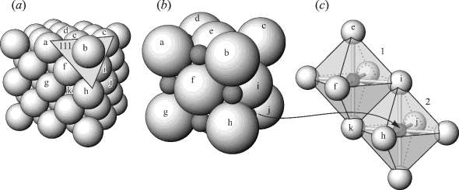
NaCl structure.

Slide 28
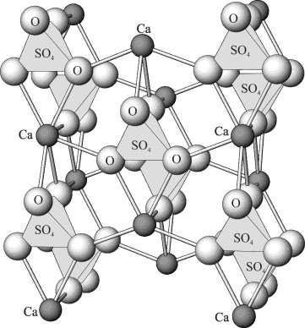
Anhydrite structure. Isolated SO₄²⁻ groups are bonded laterally through Ca²⁺ (dark spheres).

Slide 29
Crystal types: simple cubic (c), body centered cubic (bcc), face centered cubic (fcc/ccp) hexagonal close packed (hcp) etc.,

Slide 30
SUMMARY: BONDING
Type
Bond Energy
Comments
Ionic
Large!
Nondirectional (ceramics)
Variable
Directional
Covalent
large-Diamond
semiconductors, ceramics
small-Bismuth
polymer chains)
Variable
Metallic
large-Tungsten
Nondirectional (metals)
small-Mercury
Directional
Secondary
smallest
inter-chain (polymer)
inter-molecular

Slide 31
PROPERTIES FROM BONDING: T_{M}
• Bond length, r
• Melting Temperature, Tm
• Bond energy, Eo
Tm is larger if Eo is larger.

Slide 32
PROPERTIES FROM BONDING: E
• Elastic modulus, E
• E ~ curvature at ro
• E ~ curvature at ro
E is larger if Eo is larger.

Slide 33
PROPERTIES FROM BONDING: α
• Coefficient of thermal expansion, α
• α ~ symmetry at ro
α is larger if Eo is smaller.

Slide 34
SUMMARY: PRIMARY BONDS
Ceramics
Large bond energy
large Tm
large E
small α
(Ionic & covalent bonding):
Metals
Variable bond energy
moderate Tm
moderate E
moderate α
(Metallic bonding):
Polymers
Directional Properties
Secondary bonding dominates
small T
small E
large α
(Covalent & Secondary):

Slide 35
CHAPTER 3: Structures of Metals and Ceramics
ISSUES TO ADDRESS...
• How do atoms assemble into solid structures?
How do the structures of ceramic materials differ from those of metals?
• How does the density of a material depend on
its structure?
• When do material properties vary with the
sample (i.e., part) orientation?
1

Slide 36
ENERGY AND PACKING
• Non dense, random packing
• Dense, regular packing
Dense, regular-packed structures tend to have
lower energy.
2

Slide 38
Lattice and Unit Cells
Lattices:
The simplest regular array is a line of evenly spaced objects.
There is a dot at the same place in each objects.
a

Slide 39
The line of the dots is called the lattice and each lattice point must have identical surroundings.

Slide 40
One and Two dimensional Unit Cell
The unit cell for the 1-D lattice lies between two vertical lines.
a

Slide 41
The unit or the 2-D lattices are parallelograms with their corners at equivalent positions in the array.
1
2
3
5
4

Slide 42
Five 2-D lattices are possible.

Slide 43
Three dimensional unit cell
The unit cell of a 3-D is defined by three distance a,b and c and three angles α, β and γ.
z
β
α
β
y
x

Slide 44
Since the unit cells are the basic building blocks of the crystals, they must be space filling.
The 3-D unit cell includes four different types.
1. The primitive cell – has a lattice point at each corner.
2. The body centered unit cell- has a lattice point at each corner and one at the center of the cell.
3. The face centered unit cell – has a lattice point at each corner and one in the center of each face.
4. The face centered unit cell – has a lattice point at each corner and one in the centers of one pair of opposite faces. (eg., an A centered cell has lattice point in the centeres of the bc faces)

Slide 45
These are known as the seven crystal systems or classes.

Slide 46
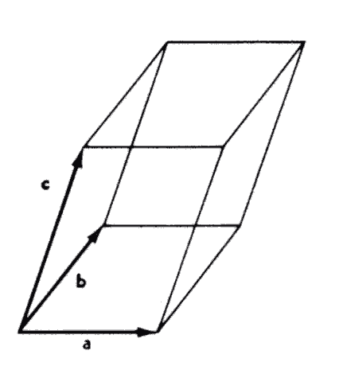
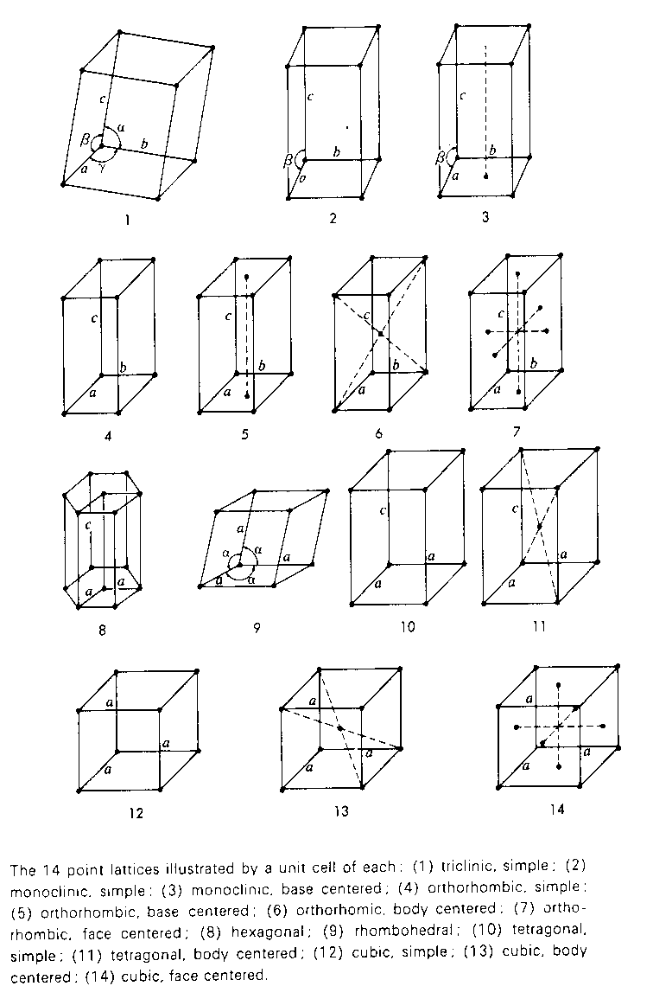
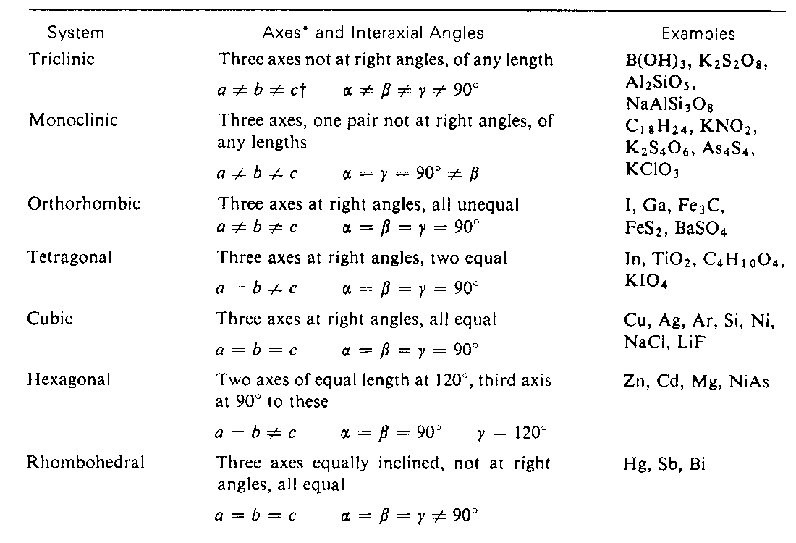
14 different point lattices, called Bravais lattices, make up the crystal system. The lengths of the sides, a, b, and c, and the angles between them can vary for a particular unit cell.

Slide 48
METALLIC CRYSTALS
• tend to be densely packed.
• have several reasons for dense packing:
-Typically, only one element is present, so all atomic
radii are the same.
-Metallic bonding is not directional.
-Nearest neighbor distances tend to be small in
order to lower bond energy.
• have the simplest crystal structures. 74 elements
have the simplest crystal structures – BCC, FCC and HCP
We will look at three such structures...
3

Slide 50
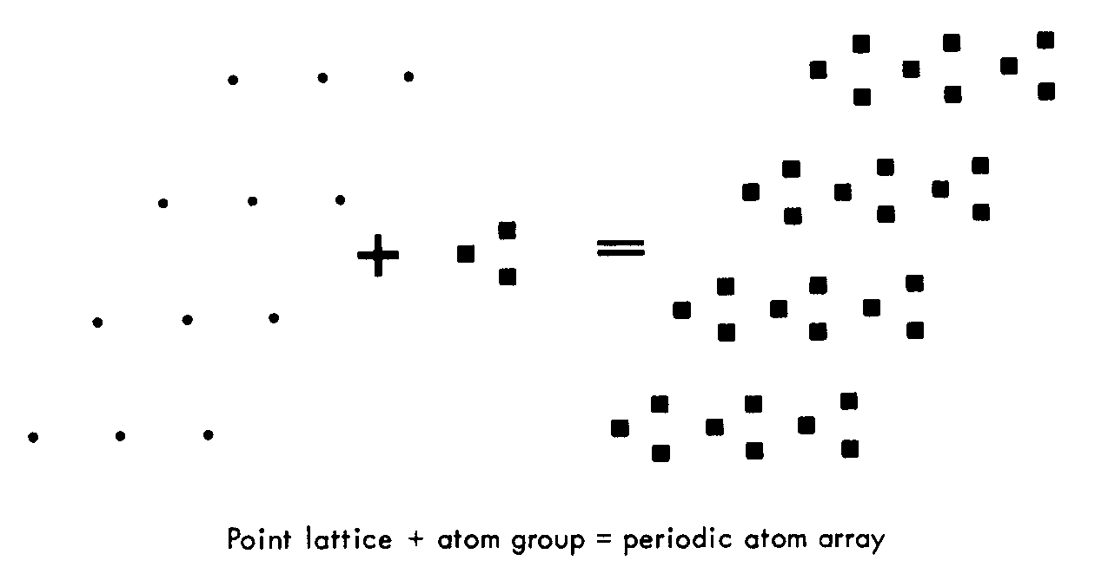
The crystal lattice
A point lattice is made up of regular, repeating points in space. An atom or group of atoms are tied to each lattice point

Slide 51
14 different point lattices, called Bravais lattices, make up the crystal system. The lengths of the sides, a, b, and c, and the angles between them can vary for a particular unit cell.

Slide 52
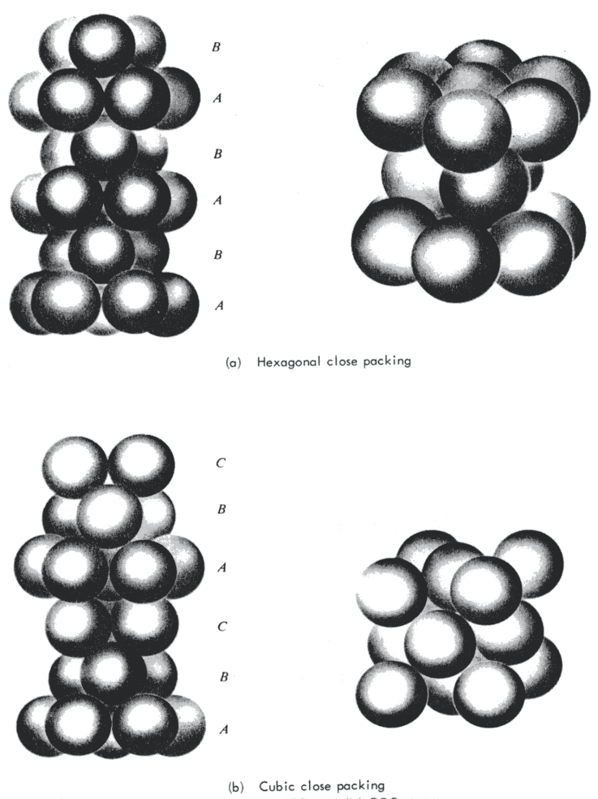
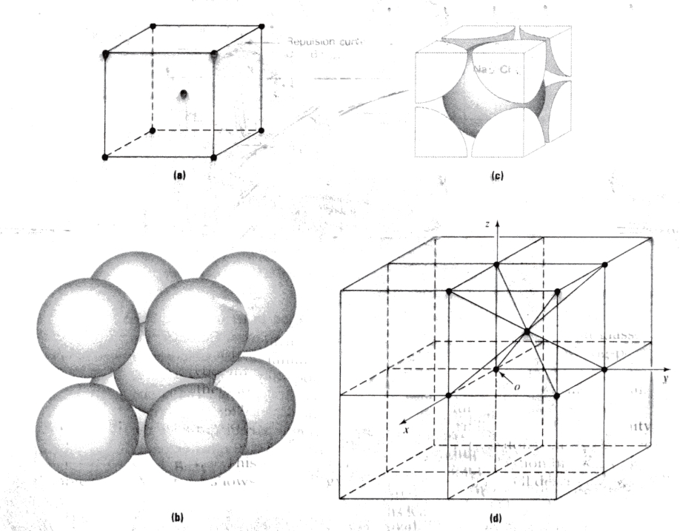
Three simple lattices that describe metals are Face Centered Cubic (FCC) Body Centered Cubic (BCC) and Hexagonal Close Packed (HCP)

Slide 53
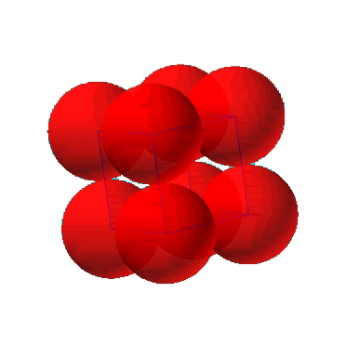
SIMPLE CUBIC STRUCTURE (SC)
• Rare due to poor packing (only Po has this structure)
• Close-packed directions are cube edges.
• Coordination # = 6
(# nearest neighbors)
Click on image to animate
(Courtesy P.M. Anderson)
4

Slide 54
ATOMIC PACKING FACTOR
• APF for a simple cubic structure = 0.52
Adapted from Fig. 3.19,
Callister 6e.
5

Slide 55
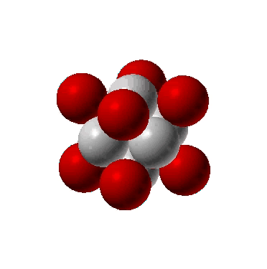
FACE CENTERED CUBIC STRUCTURE (FCC)
• Close packed directions are face diagonals.
--Note: All atoms are identical; the face-centered atoms are shaded
differently only for ease of viewing.
• Coordination # = 12
Adapted from Fig. 3.1(a),
Callister 6e.
Click on image to animate
(Courtesy P.M. Anderson)
6

Slide 56
ATOMIC PACKING FACTOR: FCC
• APF for a body-centered cubic structure = 0.74
Adapted from
Fig. 3.1(a),
Callister 6e.
7

Slide 57
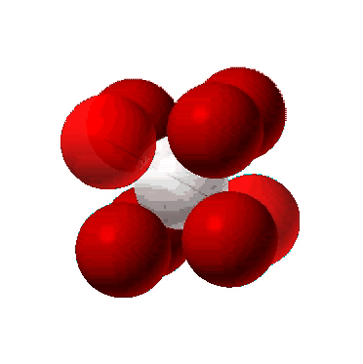
BODY CENTERED CUBIC STRUCTURE (BCC)
• Close packed directions are cube diagonals.
--Note: All atoms are identical; the center atom is shaded
differently only for ease of viewing.
• Coordination # = 8
Adapted from Fig. 3.2,
Callister 6e.
Click on image to animate
(Courtesy P.M. Anderson)
8

Slide 58
ATOMIC PACKING FACTOR: BCC
• APF for a body-centered cubic structure = 0.68
Adapted from
Fig. 3.2,
Callister 6e.
9

Slide 59
HEXAGONAL CLOSE-PACKED STRUCTURE (HCP)
• ABAB... Stacking Sequence
• 3D Projection
• 2D Projection
Adapted from Fig. 3.3,
Callister 6e.
• Coordination # = 12
• APF = 0.74
10

Slide 60
THEORETICAL DENSITY, ρ
Example: Copper
Data from Table inside front cover of Callister (see next slide):
• crystal structure = FCC: 4 atoms/unit cell
• atomic weight = 63.55 g/mol (1 amu = 1 g/mol)
• atomic radius R = 0.128 nm (1 nm = 10 cm)
-7
11

Slide 61
Characteristics of Selected Elements at 20C
Adapted from
Table, "Charac-
teristics of
Selected
Elements",
inside front
cover,
Callister 6e.
12

Slide 62
DENSITIES OF MATERIAL CLASSES
Why?
Metals have...
• close-packing
(metallic bonding)
• large atomic mass
Ceramics have...
• less dense packing
(covalent bonding)
• often lighter elements
Polymers have...
• poor packing
(often amorphous)
• lighter elements (C,H,O)
Composites have...
• intermediate values
Data from Table B1, Callister 6e.
13

Slide 63
CERAMIC BONDING
• Bonding:
--Mostly ionic, some covalent.
--% ionic character increases with difference in
electronegativity.
• Large vs small ionic bond character:
Adapted from Fig. 2.7, Callister 6e. (Fig. 2.7 is adapted from Linus Pauling, The Nature of the Chemical Bond, 3rd edition, Copyright 1939 and 1940, 3rd edition. Copyright 1960 by
Cornell University.
14

Slide 64
IONIC BONDING & STRUCTURE
• Charge Neutrality:
--Net charge in the
structure should
be zero.
--General form:
• Stable structures:
--maximize the # of nearest oppositely charged neighbors.
Adapted from Fig. 12.1, Callister 6e.
15

Slide 65
COORDINATION # AND IONIC RADII
• Coordination # increases with
Issue: How many anions can you
arrange around a cation?
Adapted from Fig. 12.4, Callister 6e.
Adapted from Fig. 12.2, Callister 6e.
Adapted from Table 12.2, Callister 6e.
Adapted from Fig. 12.3, Callister 6e.
16

Slide 66
EX: PREDICTING STRUCTURE OF FeO
• On the basis of ionic radii, what crystal structure
would you predict for FeO?
• Answer:
based on this ratio,
--coord # = 6
--structure = NaCl
Data from Table 12.3, Callister 6e.
17

Slide 67
A_{m}X_{p} STRUCTURES
• Consider CaF2 :
• Based on this ratio, coord # = 8 and structure = CsCl.
• Result: CsCl structure w/only half the cation sites
occupied.
• Only half the cation sites
are occupied since
#Ca²⁺ ions = 1/2 # F⁻ ions.
Adapted from Fig. 12.5, Callister 6e.
18

Slide 68
DEMO: HEATING AND COOLING OF AN IRON WIRE
• Demonstrates "polymorphism"
The same atoms can have more than one crystal structure.
19

Slide 69
FCC STACKING SEQUENCE
• ABCABC... Stacking Sequence
• 2D Projection
• FCC Unit Cell
20

Slide 70
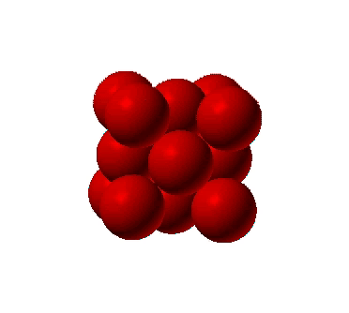
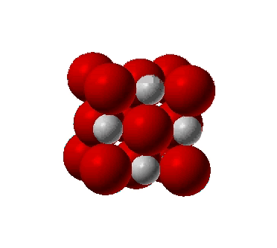
STRUCTURE OF COMPOUNDS: NaCl
• Compounds: Often have similar close-packed structures.
• Structure of NaCl
• Close-packed directions
--along cube edges.
Click on image to animate
Click on image to animate
(Courtesy P.M. Anderson)
(Courtesy P.M. Anderson)
21

Slide 71
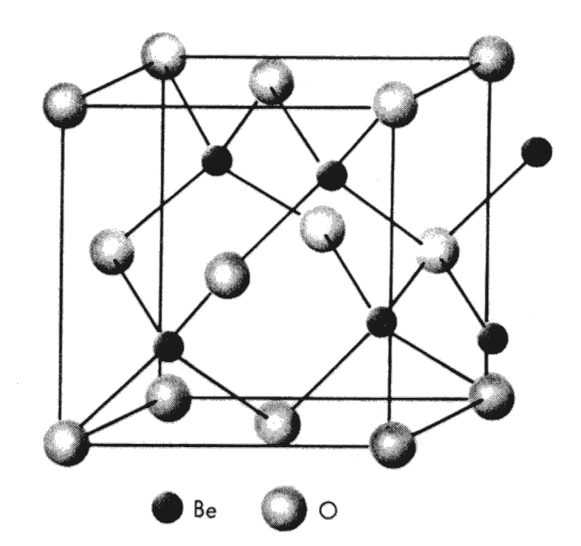
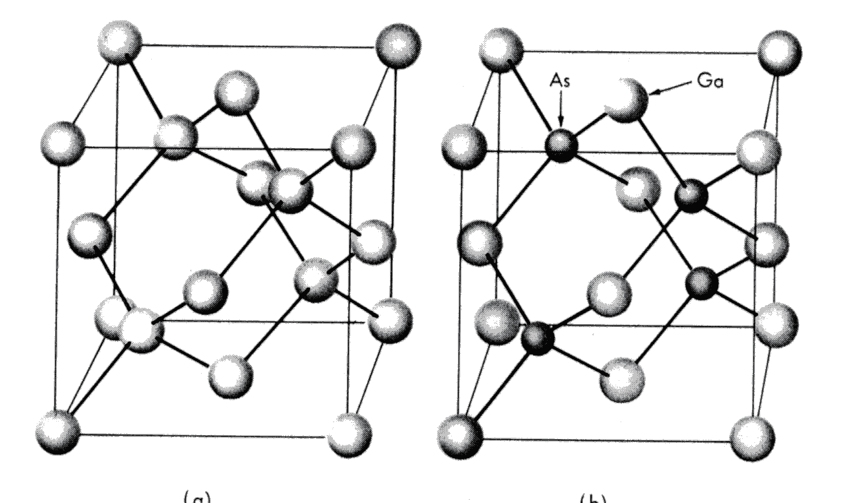
Diamond, BeO and GaAs are examples of FCC structures with two atoms per lattice point

Slide 72


CRYSTALS AS BUILDING BLOCKS
• Some engineering applications require single crystals:
--diamond single
crystals for abrasives
--turbine blades
Fig. 8.30(c), Callister 6e.
(Fig. 8.30(c) courtesy
of Pratt and Whitney).
(Courtesy Martin Deakins,
GE Superabrasives, Worthington, OH. Used with permission.)
• Crystal properties reveal features
of atomic structure.
--Ex: Certain crystal planes in quartz
fracture more easily than others.
(Courtesy P.M. Anderson)
22

Slide 73
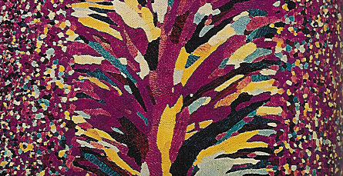
POLYCRYSTALS
• Most engineering materials are polycrystals.
Adapted from Fig. K, color inset pages of Callister 6e.
(Fig. K is courtesy of Paul E. Danielson, Teledyne Wah Chang Albany)
1 mm
• Nb-Hf-W plate with an electron beam weld.
• Each "grain" is a single crystal.
• If crystals are randomly oriented,
overall component properties are not directional.
• Crystal sizes typ. range from 1 nm to 2 cm
(i.e., from a few to millions of atomic layers).
23

Slide 74
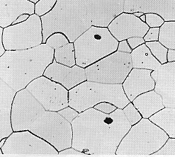
SINGLE VS POLYCRYSTALS
• Single Crystals
-Properties vary with
direction: anisotropic.
Data from Table 3.3, Callister 6e.
(Source of data is R.W. Hertzberg, Deformation and Fracture Mechanics of Engineering Materials, 3rd ed., John Wiley and Sons, 1989.)
-Example: the modulus
of elasticity (E) in BCC iron:
• Polycrystals
-Properties may/may not
vary with direction.
-If grains are randomly
oriented: isotropic.
(E_{poly iron} = 210 GPa)
-If grains are textured,
anisotropic.
200 μm
Adapted from Fig. 4.12(b), Callister 6e.
(Fig. 4.12(b) is courtesy of L.C. Smith and C. Brady, the National Bureau of Standards, Washington, DC [now the National Institute of Standards and Technology, Gaithersburg, MD].)
24

Slide 75
MATERIALS AND PACKING
Crystalline materials...
• atoms pack in periodic, 3D arrays
• typical of:
-metals
-many ceramics
-some polymers
crystalline SiO2
Adapted from Fig. 3.18(a),
Callister 6e.
Noncrystalline materials...
• atoms have no periodic packing
• occurs for:
-complex structures
-rapid cooling
"Amorphous" = Noncrystalline
noncrystalline SiO2
Adapted from Fig. 3.18(b),
Callister 6e.
26

Slide 76
GLASS STRUCTURE
• Basic Unit:
• Glass is amorphous
• Amorphous structure
occurs by adding impurities
(Na⁺,Mg²⁺,Ca²⁺, Al³⁺)
• Impurities:
interfere with formation of
crystalline structure.
• Quartz is crystalline
SiO2:
(soda glass)
Adapted from Fig. 12.11, Callister, 6e.
28

Slide 77
SUMMARY
• Atoms may assemble into crystalline or
amorphous structures.
• We can predict the density of a material,
provided we know the atomic weight, atomic
radius, and crystal geometry (e.g., FCC,
BCC, HCP).
• Material properties generally vary with single
crystal orientation (i.e., they are anisotropic),
but properties are generally non-directional
(i.e., they are isotropic) in polycrystals with
randomly oriented grains.
27

Slide 78
Miller Indices
The faces of the crystals both when they grow and when they are formed by cleavage
Tent to be parallel either to the sides of the unit cell or to planes in the crystals.
It is useful to be able to refer to both crystal faces and to the planes → by Miller indices.

